Slide 1
Camera Obstacle Avoidance
And
Multiple Targeting
By Alexandre Corcia Aguilera

Slide 2
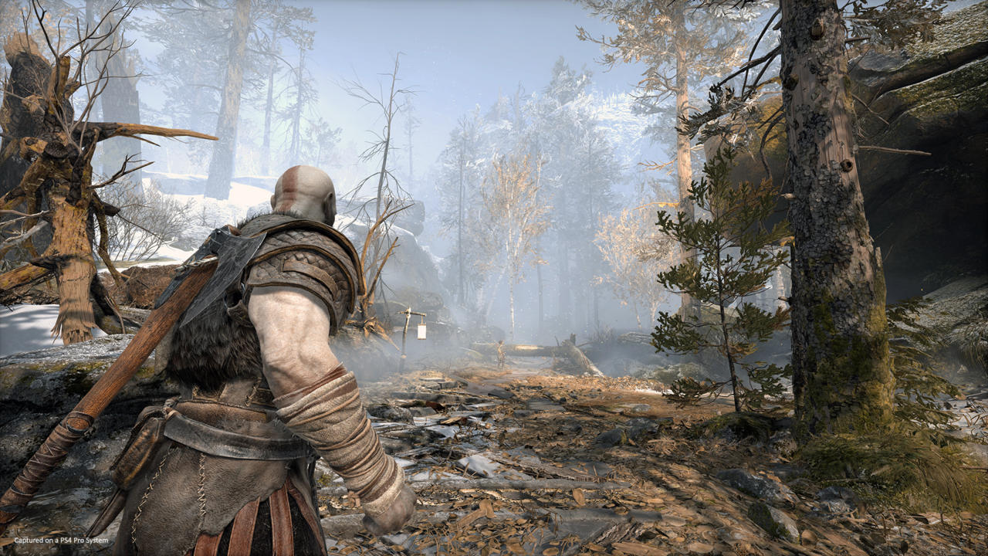
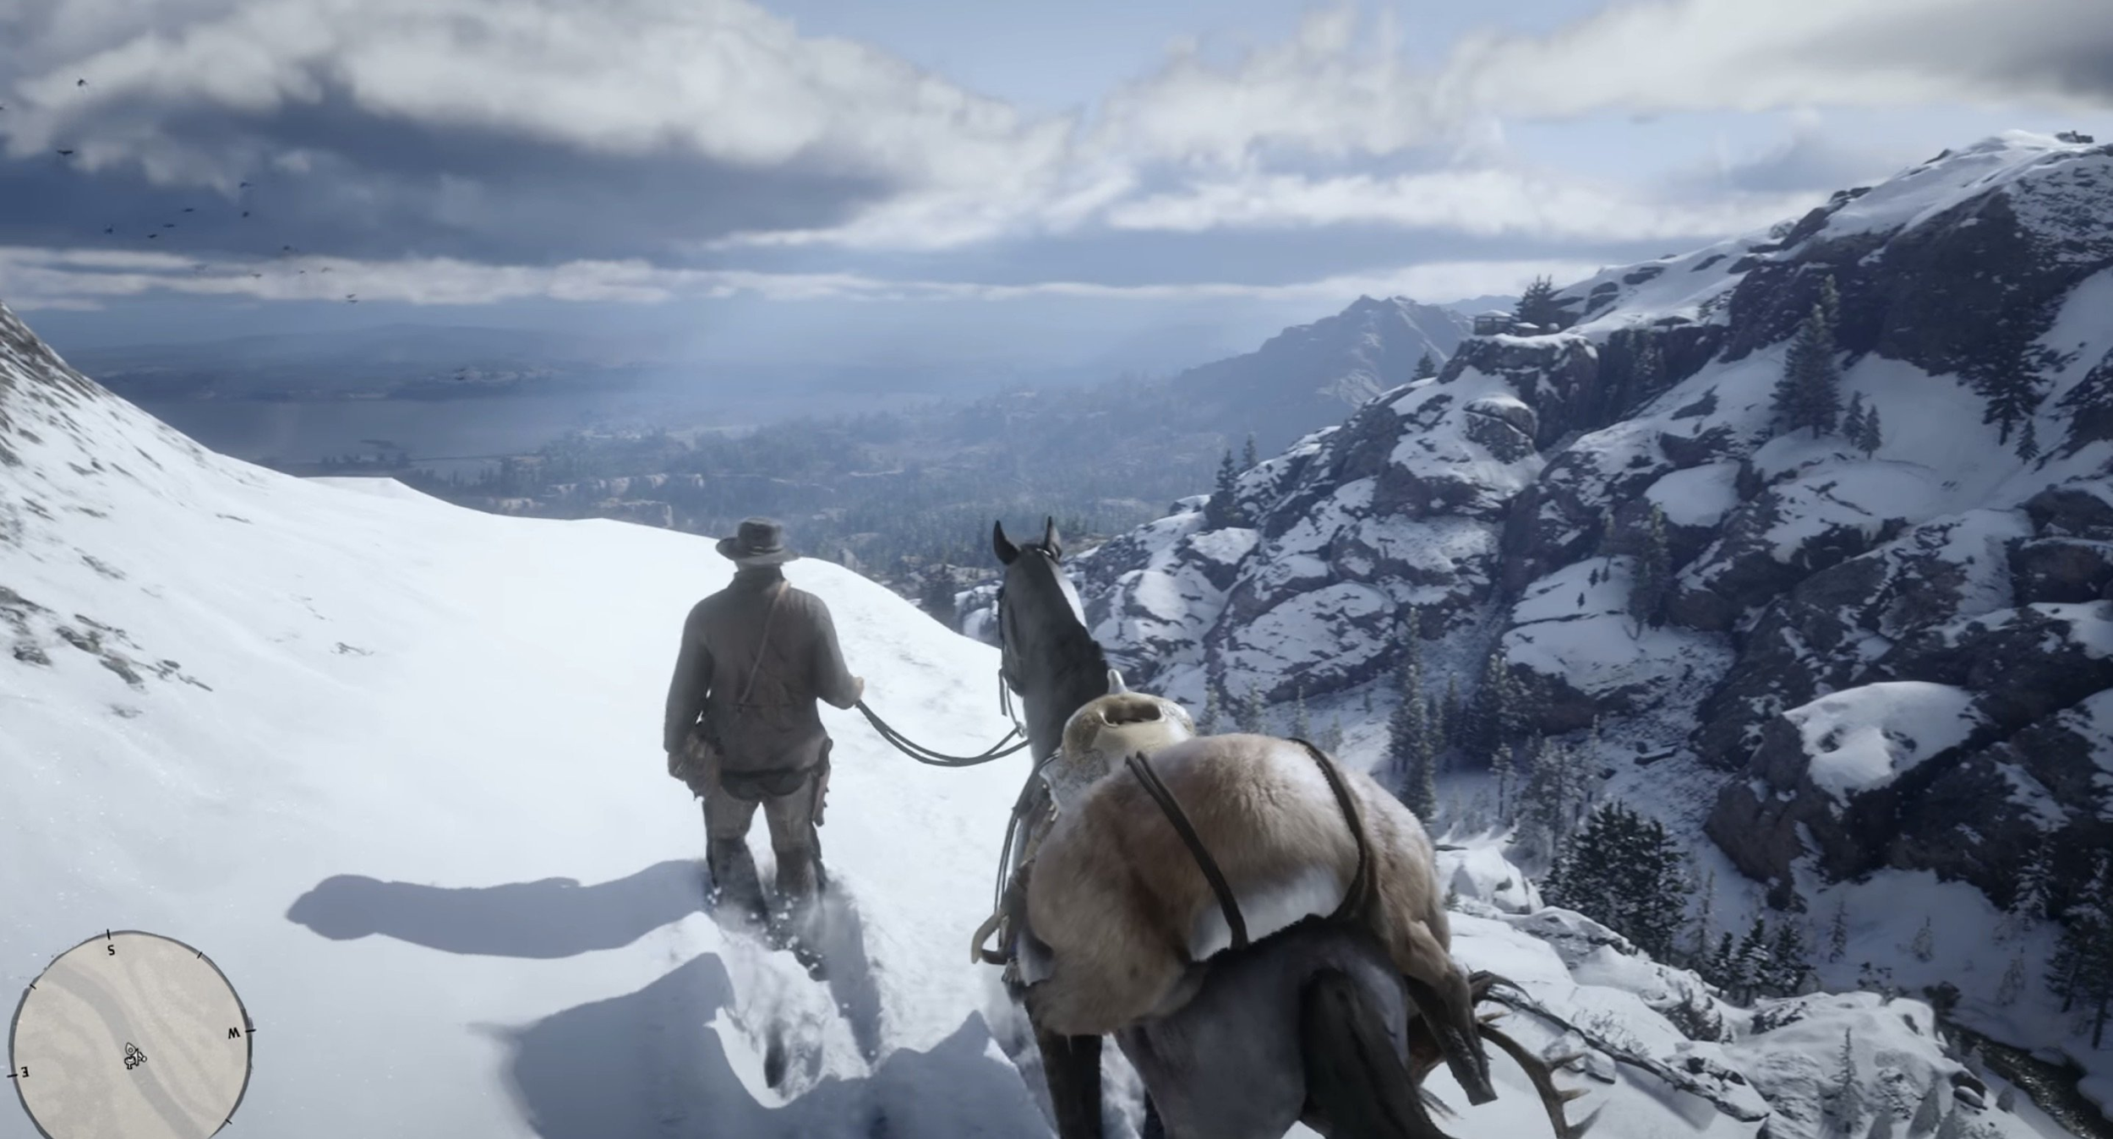

Introduction:
Notes:
One of the biggest problems when it comes to the feeling of the camera to the player when it coems to the camera is that we only notice the camera when it fails or it bothers the player:
How do we make the camera be usefu or at least be invisible.

Slide 3
Problem Explanation
Obstacle Avoidance

Slide 4
Problem Explanation: Obstacle Avoidance
What is the Issue?
Notes:
What problems are we trying to fix ?

Slide 5
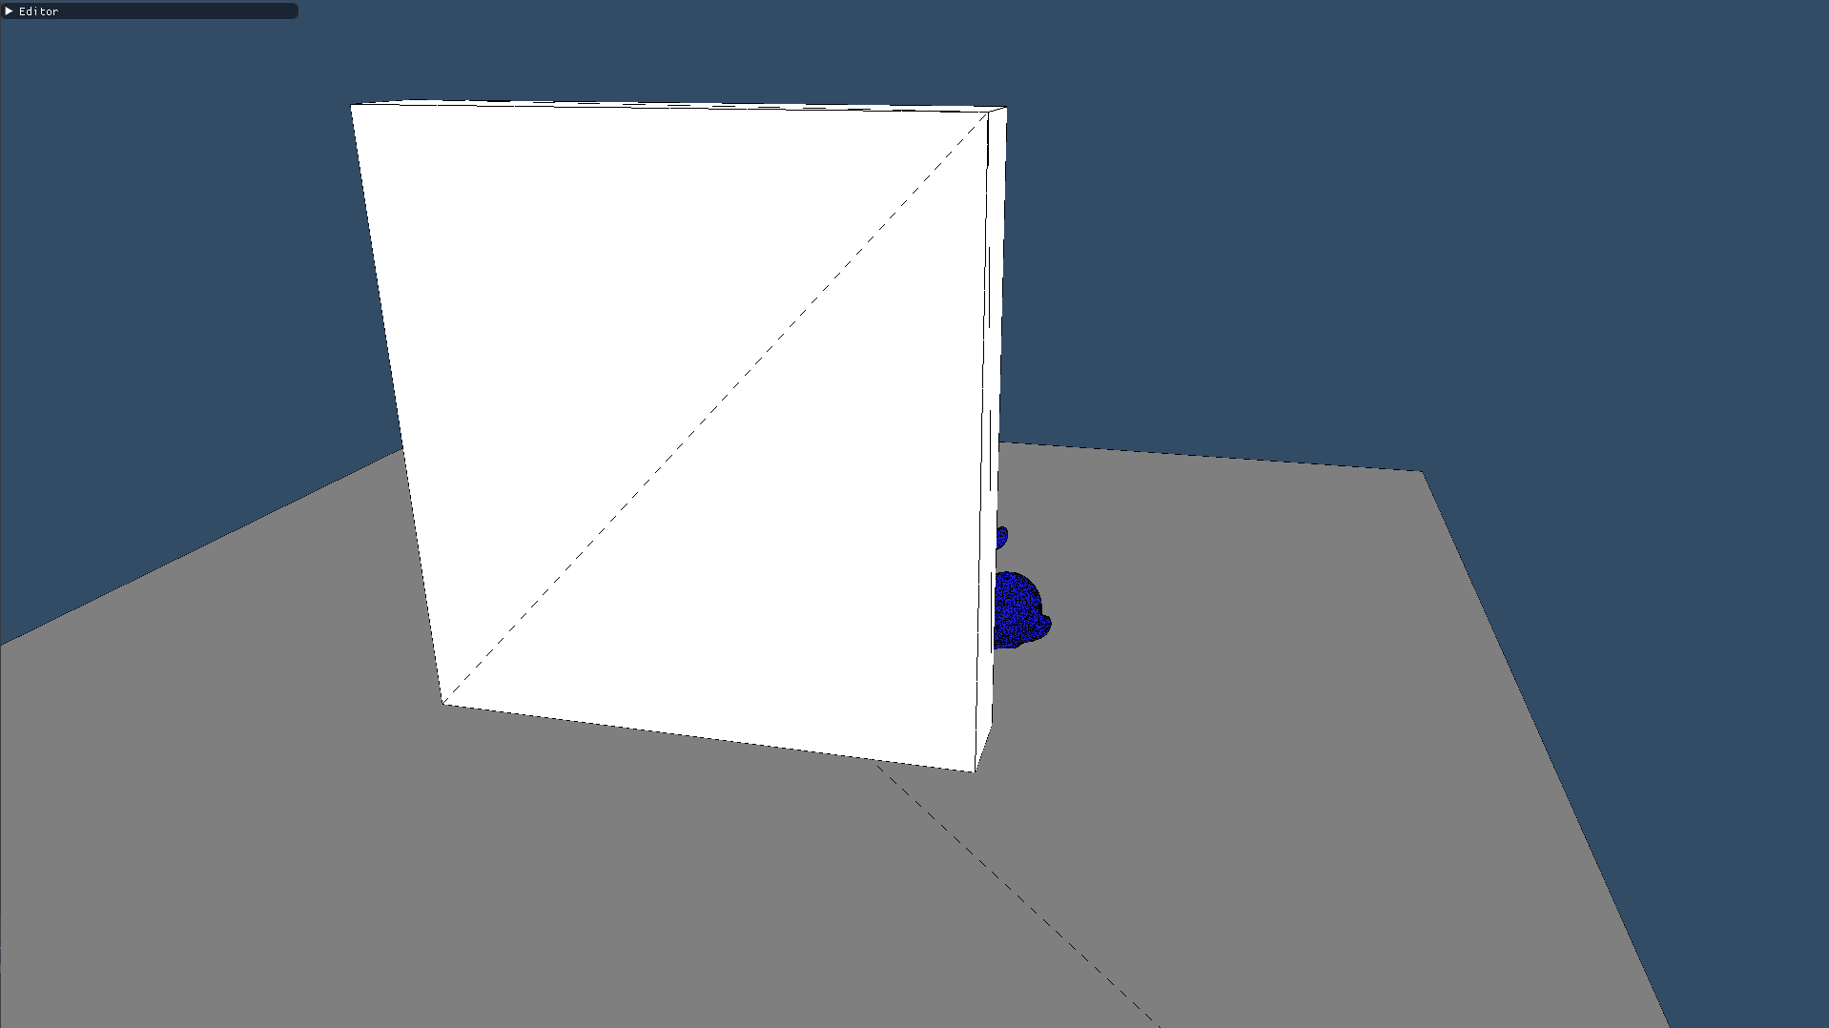
Problem Explanation: Obstacle Avoidance
Notes:
We can already see the problem in this picture. but there are more issues than the ones we can see in first hand.:
First of all we can’t see the object that we are targeting meaning that the player doesn’t know how what is going on.

Slide 6
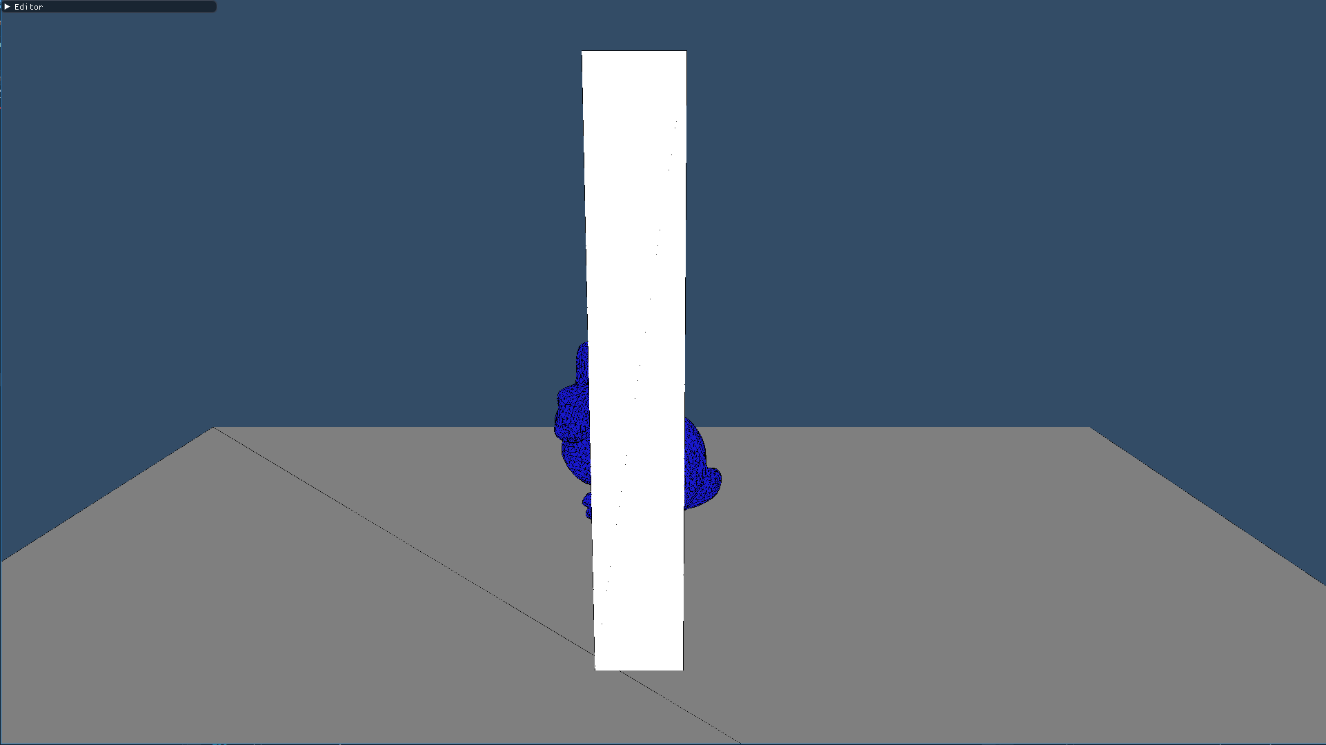
Problem Explanation: Obstacle Avoidance
Notes:
Apart from that, how can we know if we are seeing the entire object or just part of it?
In the case where we are trying to solve this problem, what side should the camera go to?
How do we know what side is better left or right ?

Slide 7
Problem Explanation
Multiple Targeting

Slide 8
Problem Explanation: Multiple Targeting
What is the Issue?
Notes:
What problems are we trying to fix ?

Slide 9
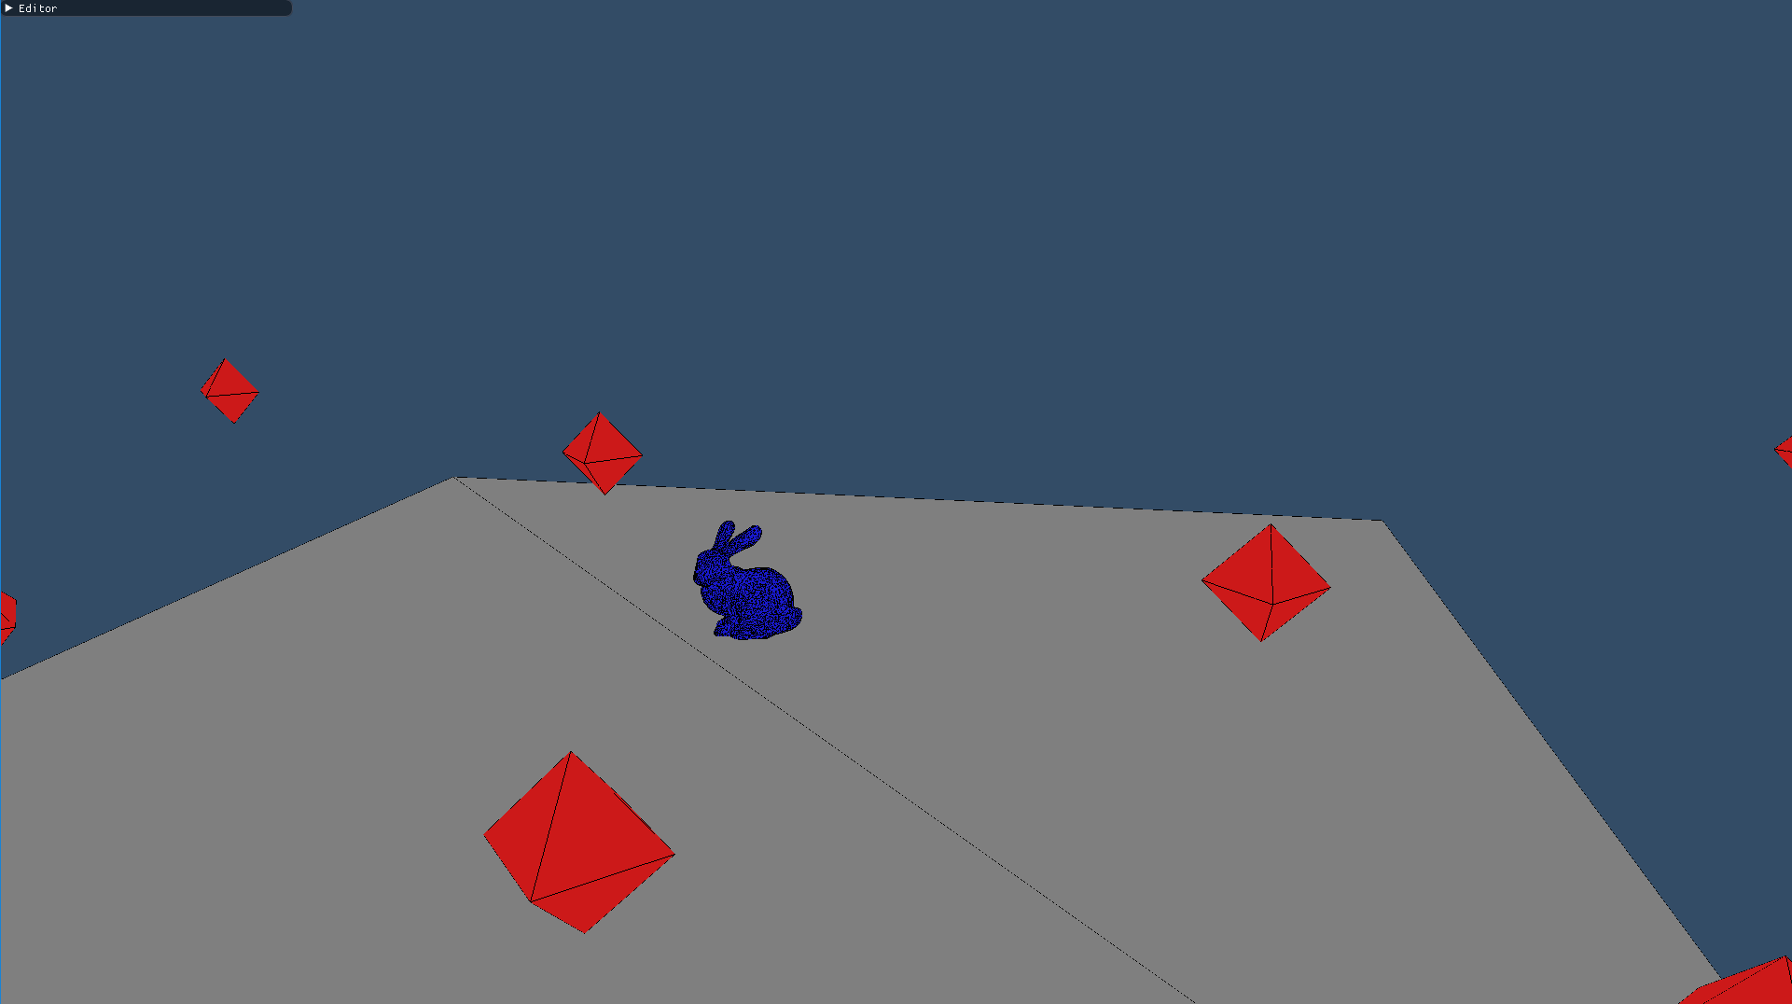
Problem Explanation: Multiple Targeting
Notes:
When it comes to having multiple targets, the main problem is not having any of the agents out of the camera or getting them out of the shot because we are trying to get other in.
Some targets are partially visible others are out of the camera’s field of view

Slide 10
Obstacle Avoidance
Detecting The Problem

Slide 11

Obstacle Avoidance: Detecting The Problem
Notes:
So we have a camera and a target, it looks simple right ?

Slide 12
Obstacle Avoidance: Detecting The Problem
Notes:
Throw a ray and check if it comes back from with the first object being the target right ?

Slide 13
Obstacle Avoidance: Detecting The Problem
Notes:
If not we are not/

Slide 14
Obstacle Avoidance: Detecting The Problem
Notes:
What happens if the camera can only see part of the target but the center (the position of the target) can be seen by the camera meaning that the ray would indeed return that he is seeing the target but is only really seeing it partially.

Slide 15
Obstacle Avoidance: Detecting The Problem
Notes:
The solution is to throw multiple targets and that is it.
But we can't do that to to a complex mesh so instead of doin

Slide 16
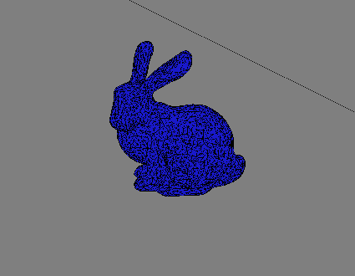
Obstacle Avoidance: Detecting The Problem
Notes:
But doing so with a complex mesh would be death for computations,

Slide 17
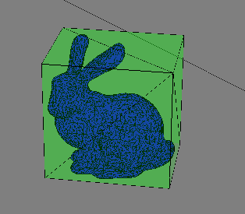
Obstacle Avoidance: Detecting The Problem
Notes:
So we use bounding boxes to be able to limit the ray throwing to 8 each corner of the boxes and that is it.

Slide 18
Obstacle Avoidance
Solving The Problem

Slide 19
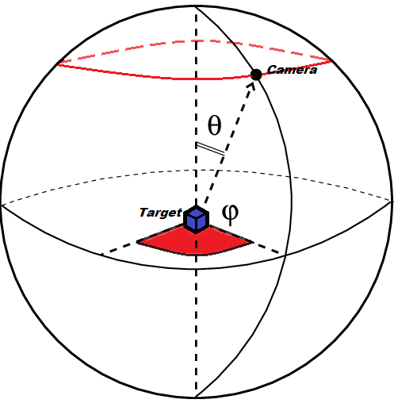
Obstacle Avoidance: Solving the Problem
Notes:
Movement of the camera will be done with spherical coordinates, easy enough
We will be moving one of the angles so that the camera will be moving on that red line.

Slide 20
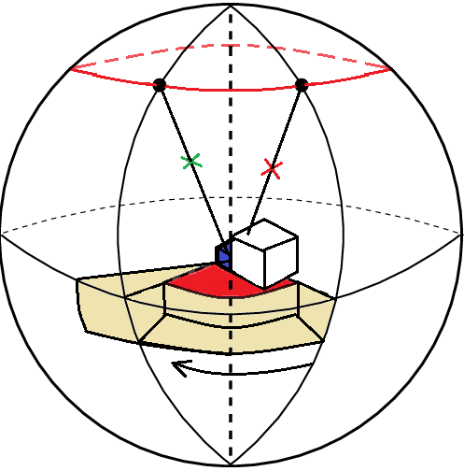
Obstacle Avoidance: Solving the Problem
Notes:
Then when we habve an obstacle that is bothering the view we simply move the camera to another position and check again and repite until we found a beteter position.

Slide 21
Obstacle Avoidance: Solving the Problem
Notes:
But remember this ? how do we know what is the better side:

Slide 22
Obstacle Avoidance: Solving the Problem
Percentage of Vision
&
Distance from OP
Notes:
Percentage of vision will be computed with the rays
And the distance of vision will be the difference between the starting angle to the new onew

Slide 23
Obstacle Avoidance: Solving the Problem
Going Left :
Percentage of 1.0
Distance of 65 degrees
Going Right :
Percentage of 1.0
Distance of 75 degrees

Slide 24
Obstacle Avoidance: Solving the Problem
Going Left :
Percentage of 1.0
Distance of 65 degrees
Going Right :
Percentage of 1.0
Distance of 75 degrees

Slide 25
Multiple Targeting
Detecting The Problem

Slide 26
Multiple Targeting: Detecting the problem
Notes:
we need to take into account all of what the camera sees, meaning we can’t assume that the camera will be looking at the direction of each entity so raycasting is not going to be a direct solution similar to obstacle avoidance.
Must use frustum and frustum collision

Slide 27
Multiple Targeting: Detecting the problem
Notes:
we need to take into account all of what the camera sees, meaning we can’t assume that the camera will be looking at the direction of each entity so raycasting is not going to be a direct solution similar to obstacle avoidance.
Must use frustum and frustum collision

Slide 28
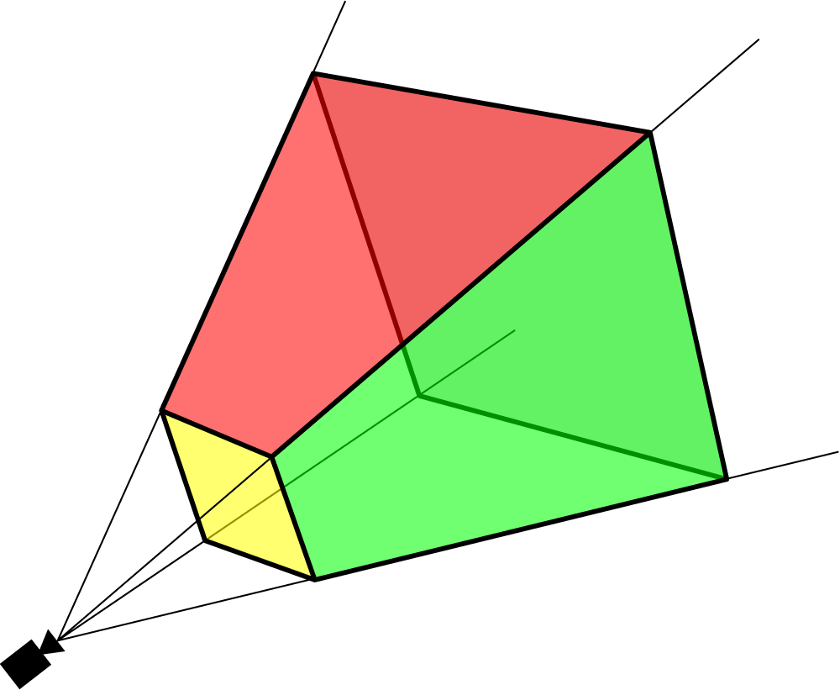
Multiple Targeting: Detecting the problem
Notes:
we need to take into account all of what the camera sees, meaning we can’t assume that the camera will be looking at the direction of each entity so raycasting is not going to be a direct solution similar to obstacle avoidance.
Must use frustum and frustum collision

Slide 29
Multiple Targeting
Solving The Problem

Slide 30
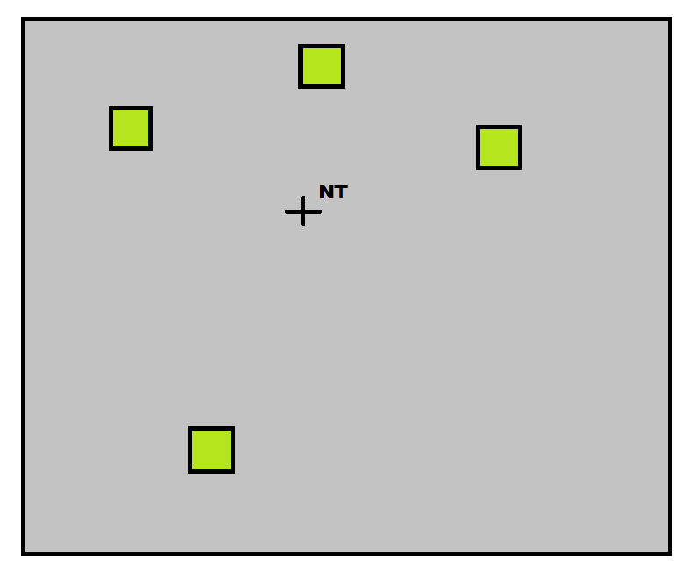
Multiple Targeting: Solving the problem
Notes:
AVERAGE OF THE TARGETS POSITION

Slide 31
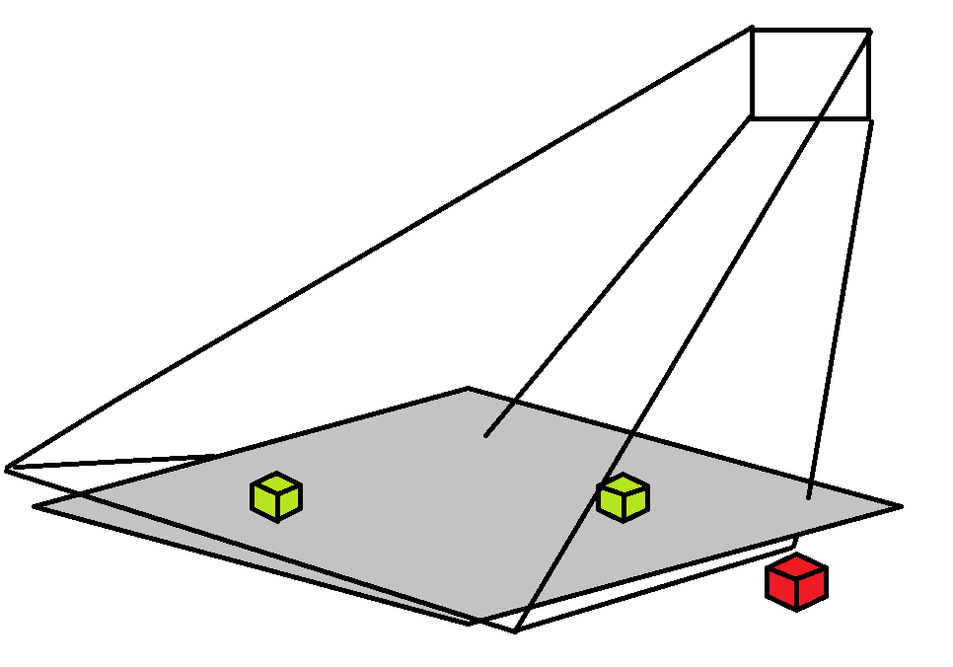
Multiple Targeting: Solving the problem
Notes:
then we check if we all the targets are inside of the frustum and not

Slide 32
Multiple Targeting: Solving the problem
Distance to NT
Notes:
We modify the distance.

Slide 33
Multiple Targeting: Solving the problem
Distance to NT

Slide 34
Multiple Targeting: Solving the problem

Slide 35
Multiple Targeting: Solving the problem

Slide 36
Multiple Targeting: Solving the problem

Slide 37
Demo:

Slide 38
Thank you for your attention,
Any questions ?

